Slide 1
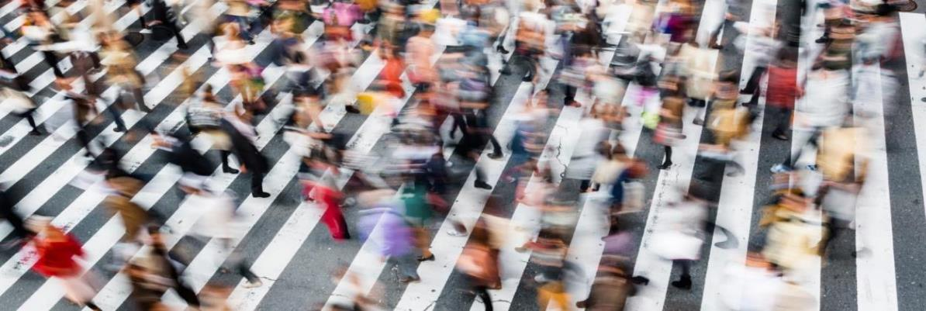




Anthropolis Chair
Jakob Puchinger

Slide 2
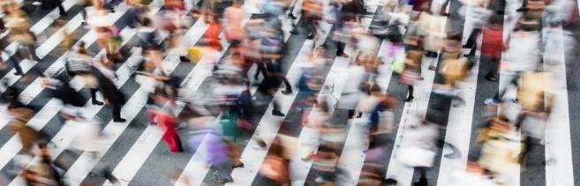

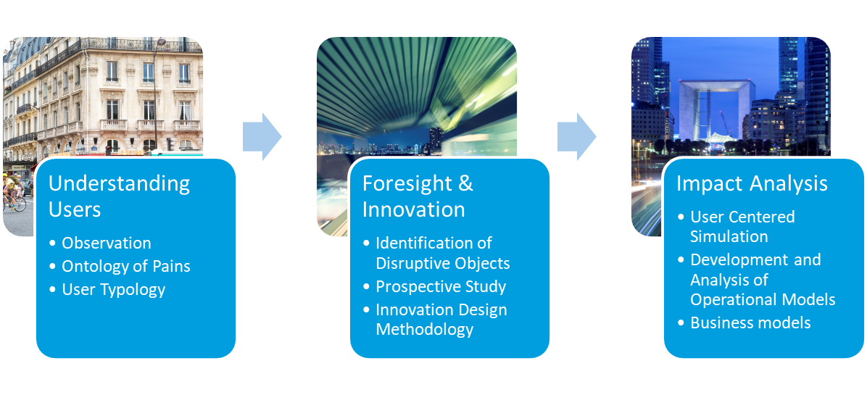
The Anthropolis Chair
Human centered innovation in the context of urban mobility systems
4/2015-3/2019
2 key researchers
4 PhD Students
Several Master Students, Interns and Student Projects
3 Public Workshops
> 20 Scientific Publications & Presentations
8 Deliverables

Slide 3
Understanding Users
Challenges
Results / Technology
Traveller eXperience
Model
Identification of traveller profiles
Identification and understanding of travel induced pains
Categories of travel problems
Modeling traveler specific attributes within Simulation

Slide 4
Foresight and Innovation
Challenges
Results / Technology
Identification of disruptive Objects
Human centered view of the future
Innovation Opportunities
Study: The traveler in future urban mobility scenarios
Methodology for identifying innovation opportunities in urban mobility

Slide 5
Impact
Challenges
Results / Technology
How to integrate a qualitative user perspective in Simulation Methods?
How to operate innovative services and assess their impact?
Integration of traveller centric view in Simulation Tools
Operation Strategies for innovative Services
Impact analysis

Slide 6
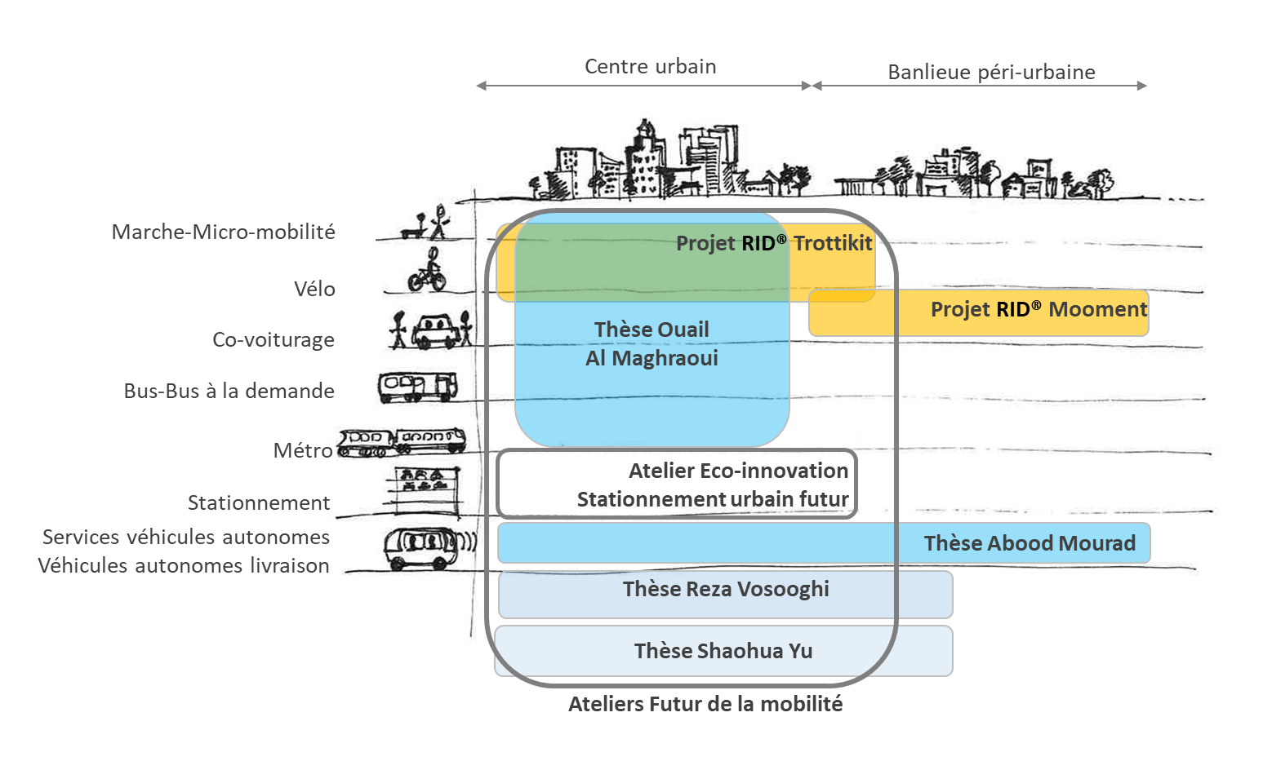
Overview of the activities
Adapted from Brimont et al. (2016)
Notes:
Résumé contexte / objectifs / figure livret
+ Bilan factuel (thèmes, livrables, thèses, workshops, conférences, collaborations, enseignement, projets, interventions, twitter, etc)
+ Zoom thèse par doctorants
+ Zoom projet innovation
+ Zoom Atelier prospectif
+ Zoom Véhicule El / Véhicule Autonome
+ XXX Conclusion XXX

Slide 7
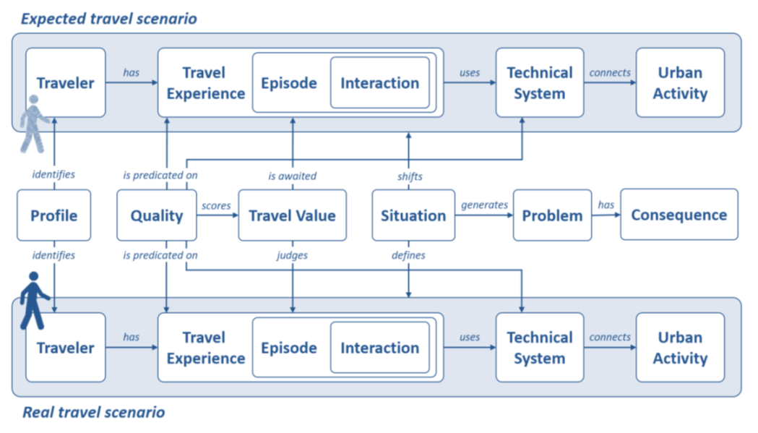
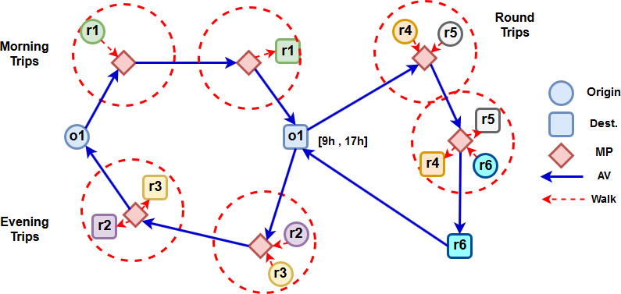
PhD theses
Ouail Al Maghraoui (2016-2019)
  “Designing for urban mobility-Modeling the traveler experience” Supervised by J. Puchinger, F. Vallet, B. Yannou
Abood Mourad (since 06/2016)
  “Synchronizing passenger and freight flows in urban mobility systems” Supervised by J. Puchinger and C. Chu

Slide 8
PhD Theses
Réza Vosooghi (since 11/2016)
  « Innovative last mile transportation service-system design and modeling». Supervised by
  M. Jankovic and J. Puchinger
  Performed within MSM project.
Shaohua Yu (since 10/2017)
  « Optimization models and methods for tour planning in smart urban logistics».
  Supervised by
  J. Puchinger and S. Sun.
  CSC scholarship.

Slide 9
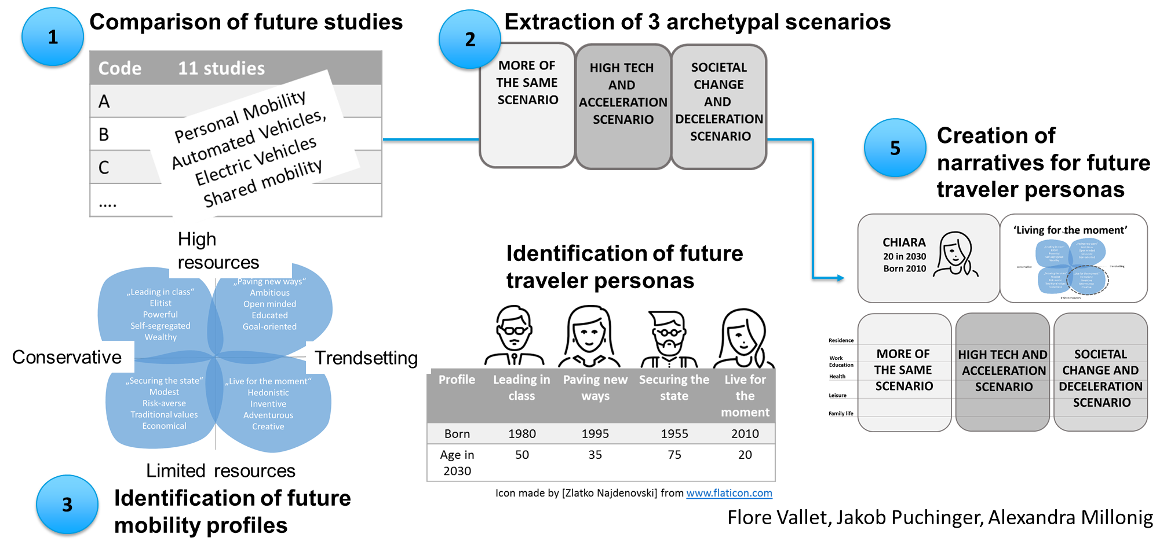
Future mobility workshops
Combining personas and future scenarios: Overview

Slide 10
