Slide 1



Floating Car Data Mining:
Identifying Vehicle Types in relation to Usage Patterns
Danyang SUN
Supervised by
Fabien LEURENT
Xiaoyan XIE
Chaire Île-de-France Mobilités
La conférence anniversaire
Feb 11th, 2019
Notes:
Logo of ENPC and Telecom

Slide 2
1 Introduction
Background
  Mobility entities are more connected
  FCD → detailed traces of the vehicle movement
  By mining→ understand vehicle mobility
Notes:
As we all know, digital profound changes in our lifes especially with massive data
In mobility field enable, more and more are connect enable us
This actually provides

Slide 3
1 Introduction
Objectives
  To recover information from FCD to explore mobility patterns
    Identify vehicle types in terms of activity context
    Assess the type association to the use of different classes of roadways
Notes:
Cost effective
easy to deploy
high temporal resolution
wide spatial coverage
Travel behavior analysis not fully excavated
Great potential in travel behavior analysis, exp. variation over time, OD specific heterogeneity and exploration with big data

Slide 4
Contents
Introduction
Data Reconstitution
Descriptive Analysis
Type Identification
Roadway Usage Assessment
Conclusion and Discussions

Slide 5
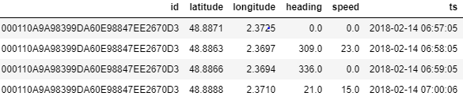
Data constitution
2 DATA
Data | Time Window | Region | Contents | Sample size
FCD | Feb 14th 0h -24h (Wednesday) | Ile de France | Vehicle ID GIS coordinates Speed Timestamp Heading | 13.8 million records
Data Introduction-FCD
  Provider:
    Coyote
  A sequence of active vehicle state logs
    by 30s to 60s
Original data example
Notes:
Cost effective
easy to deploy
high temporal resolution
wide spatial coverage
Travel behavior analysis not fully excavated
Great potential in travel behavior analysis, exp. variation over time, OD specific heterogeneity and exploration with big data

Slide 6
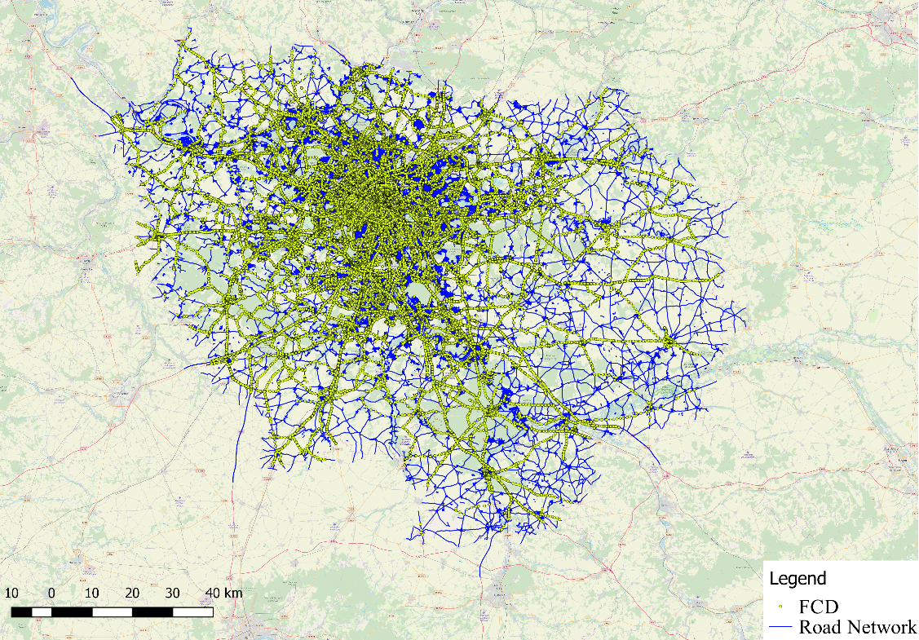
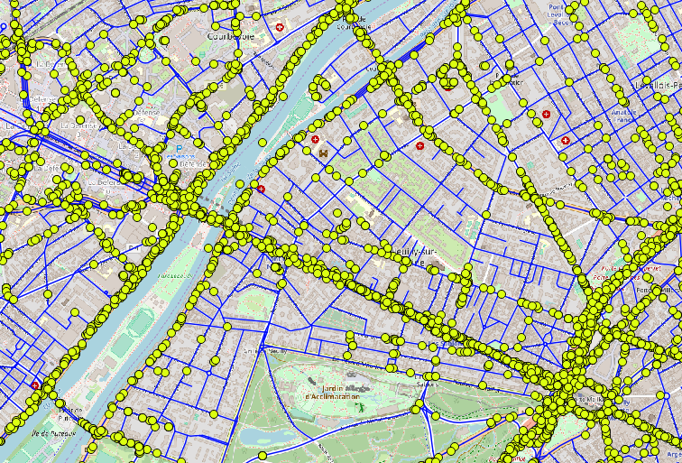
2 DATA
Data Introduction-
GIS road networks
  Source:
  extracted from OSM
  Geocoded with FCD to spatially join the road use info
    Assign to the nearest
Notes:
Cost effective
easy to deploy
high temporal resolution
wide spatial coverage
Travel behavior analysis not fully excavated
Great potential in travel behavior analysis, exp. variation over time, OD specific heterogeneity and exploration with big data

Slide 7
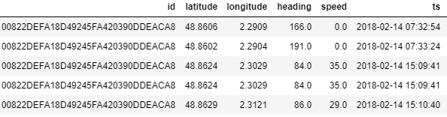
2 DATA
Segmenting the trajectories into meaningful trips
No absolute indicator in original dataset
Major criteria: >20 minutes time interval, by:
  Dabiri & Heaslip (2018)
  Time interval inspection analysis
Data Processing
  Recover trips (as a unit)
    OD location
    OD timestamp
    Distance
    Speed
Trip 1
time
time dif
> 20 min?
Trip 2
Notes:
It comes
The information calculated

Slide 8
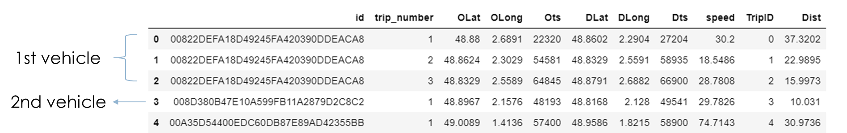
2 DATA
Recover each trip of vehicles and their features
196,554 trips (190K)
68,613 unique vehicles (68K)
2.9 trips/ vehicle
Generating new dataset
  Each row is a single trip
    Column as features
  Tracked by Vehicle ID
    # of trips
New dataset
Notes:
The first 3 tirps belongs to the 1st

Slide 9
Contents
Introduction
Data Reconstitution
Descriptive Analysis
Type Identification
Roadway Usage Assessment
Conclusion and Discussions

Slide 10
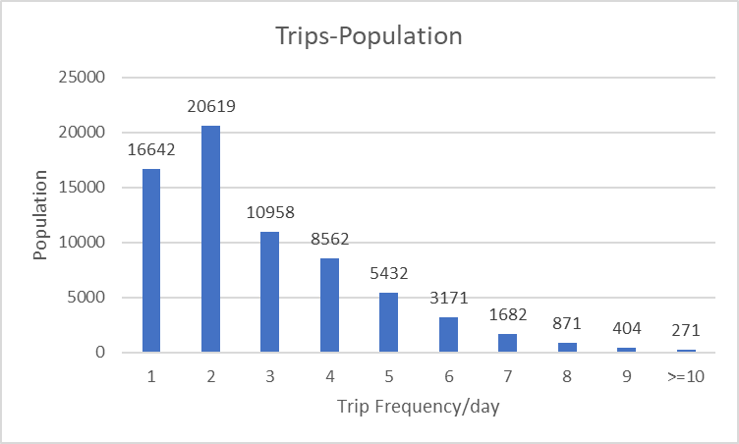
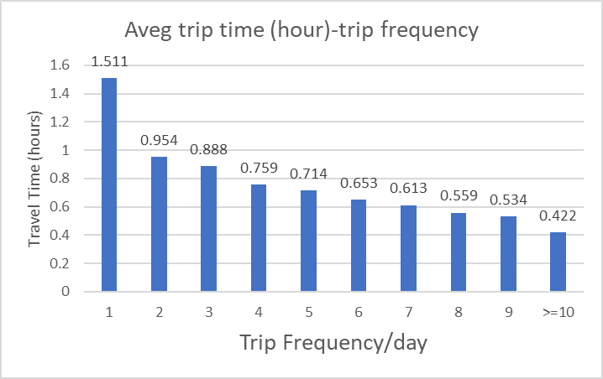
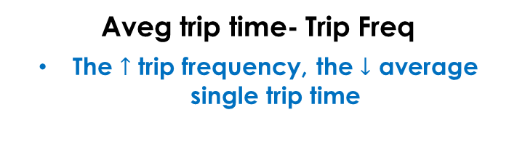
 | Average | Median | 1st Quartile | 3nd Quartile
# Trips /vehicle | 2.9 | 3 | 2 | 4
Trip Duration (h) | 0.8 | 0.5 | 0.2 | 1.0
Distance (km) | 27 | 14 | 4 | 37
Speed (km/h) (average by observations) | 32 | 28 | 14 | 45
3 Descriptive Analysis
Summary of
Data Statistics
Population-Trip Freq.
Predominant frequency: 2 trips/day
Aveg trip time- Trip Freq
The $↑$ trip frequency, the $↓$ average single trip time

Slide 11
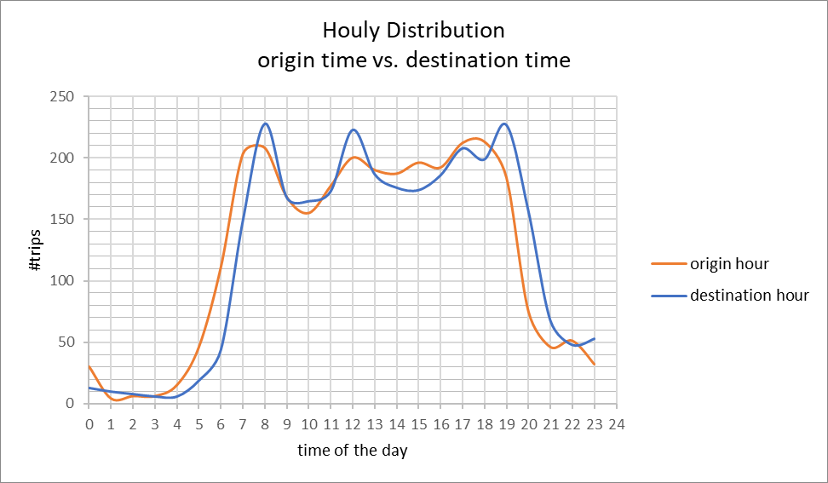
3 Descriptive Analysis
Departure time
vs.
Arrival time
Major trips happen from 7h to 19h
2 peaks of Departure Time
3 peaks of Arrival Time
Notes:
Departing trips
Arrving trips
Trips at the origin
Trips at the destination

Slide 12
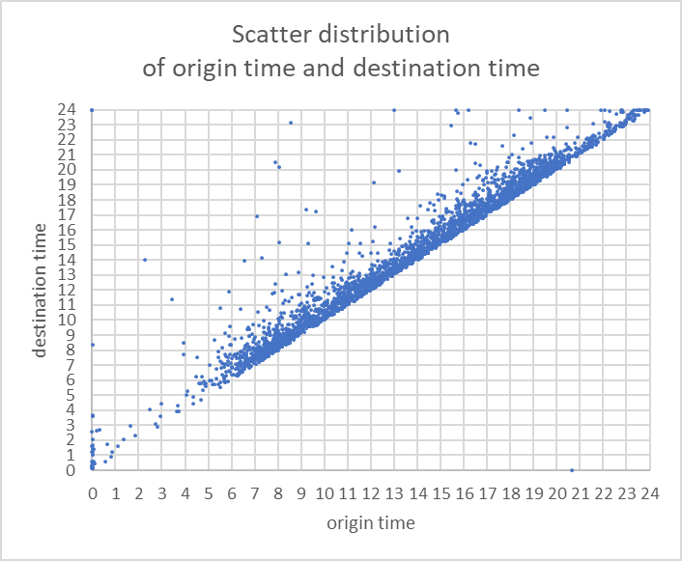
3 Descriptive Analysis
Departure time
vs.
Arrival time
Each point represent a trip
Mainly distributed along the diagonal line
Most are short trips (75%< 1h)

Slide 13
Contents
Introduction
Data Reconstitution
Descriptive Analysis
Type Identification
Roadway Usage Assessment
Conclusion and Discussions

Slide 14
4 Type Identification
Methodology-Two Steps Clustering
1
2
Identify Trip Types
(based on trip features)
Each trip is labeled with a specific type
Identify Vehicle Types
(based on its trip profiles)
For each trip type, how many trips does a vehicle make in one day?
Notes:
Find the meaning for a trip

Slide 15
4 Type Identification
Methodology-Two Steps Clustering
1
2
Identify Trip Types
(based on trip features)
Each trip is labeled with a specific type
Identify Vehicle Types
(based on its trip profiles)
For each trip type, how many trips does a vehicle make in one day?

Slide 16
4 Type Identification
(1) Trip Clustering Analysis
Trip data for clustering:
  Select independent features: 1)Departure time; 2)Travel Distance; 3)Speed
Sampling: due to the limitation of computation power
  Only 1000 random vehicles selected: 2904 trips, 190K logs
  Trial analysis for the methodological feasibility
  Scalable with cloud techniques and more computation resources.

Slide 17
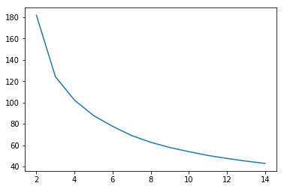
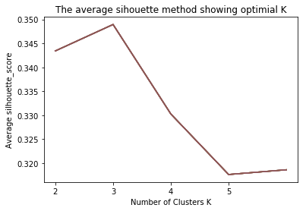
4 Type Identification
(1) Trip Clustering Analysis
Method: K-means clustering
  Partitioning into K groups
  While minimizing within-cluster variance
Choosing K
  Elbow method
  Average silhouette analysis
  Optimal K =3
Elbow method
Average silhouette
analysis
Notes:
Metgif

Slide 18
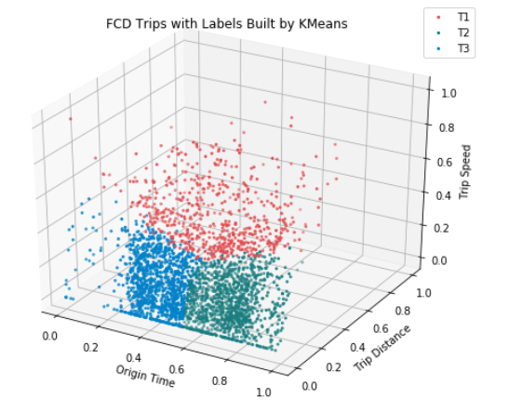
4 Type Identification
(1) Trip Clustering Analysis
Results: K-means clustering
T1 (trip type1): Long distance trips (with medium-high speed, no concentrated origin time)
T2: Evening short trips (low distance and speed)
T3: Morning short trips (low distance and speed)

Slide 19
4 Type Identification
Methodology-Two Steps Clustering
1
2
Identify Trip Types
(based on trip features)
Each trip is labeled with a specific type
Identify Vehicle Types
(based on its trip profiles)
For each trip type, how many trips does a vehicle make in one day?

Slide 20
4 Type Identification
(2) Vehicle Type Clustering
Generate vehicle trip profiles
  Count the trip number in each type
  T1, T2, T3 represents the identified trip types
K-means: Choosing K
  by Elbow and Average Silhouette
  Optimal K=4
 | Trip T1 (Long dist trip) | Trip T2 (Morning st trip) | Trip T3 (Evening st trip)
Vehicle ID 1 | # | # | #
…. | # | # | #
Vehicle ID n | # | # | #
Notes:
Change the color of columns
Count the trips numbers in each type for the vehicles

Slide 21
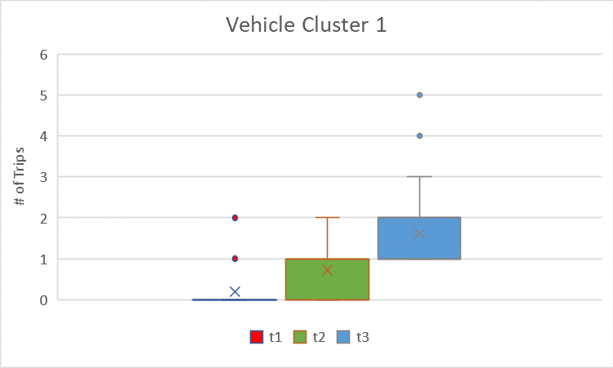
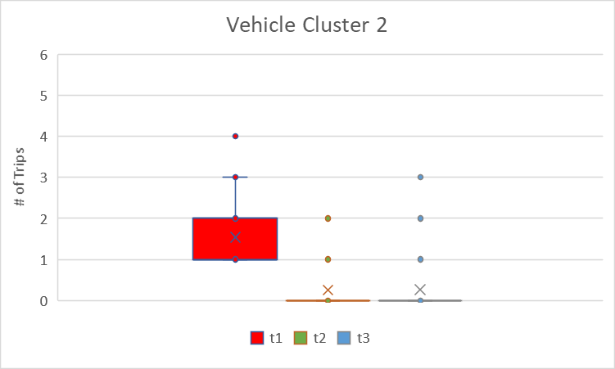
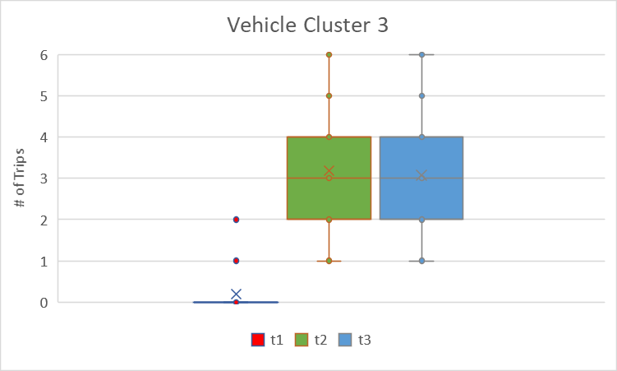
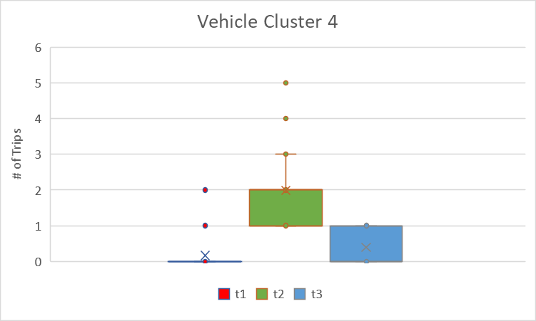
4 Type Identification
(2) Vehicle Type Clustering
Results: partitioned into 4 clusters. (comparing trip profiles by box plots)
# trips
Vehicle Type | T1 (long distance trip) (frequency) | T2 (evening short trip) (frequency) | T3 (morning short trip) (frequency) | Vehicle population | Distance Travelled | Inference
1 | Rare | Low | Medium | 32.8% | 25% | Morning Activity Based
2 | Medium | Rare | Rare | 31.1% | 48% | Long Distance Traveling
3 | Rare | High | High | 13.3% | 15% | Frequent Activity Based
4 | Rare | Medium | Low | 22.7% | 12% | Evening Activity Based
Notes:
To know the meanin of each cluster

Slide 22
4 Type Identification
(2) Vehicle Type Clustering
Vehicle type:
qualitive characterization
4 Vehicle Clusters
Long Distance Traveling
(fewer but long trips, commuting)
#Trip:2.05 (aveg); Tot dist.: 48%
Morning & Evening
Morning Activity Based
(moderate trips, temporally imbalanced)
#Trip:2.53 (aveg); Tot dist.: 25%
Evening Activity Based
(moderate trips, temporally imbalanced)
#Trip:2.58 (aveg); Tot dist.: 12%
Frequent Activity Based
(more trips, frequent activity)
#Trip:6.50 (aveg); Tot dist.: 15%
Notes:
To further characze qualitively, we drew a digam

Slide 23
Contents
Introduction
Data Reconstitution
Descriptive Analysis
Type Identification
Roadway Usage Assessment
Conclusion and Discussions

Slide 24
Objective
  Applicable use case: find out over-presented outcomes of certain types
  In specific, examine usage association to different classes of roadways
Why?
  Different hierarchies(classes) of roadways
  Customer-ship of each layer (joint use, splits of vehicles)
  Methodology transferable to other post-behavior performance (violation, accidents)
5 Roadway Usage Assessment
Objectives
Notes:
The developed method approach is expected to be tranfer

Slide 25
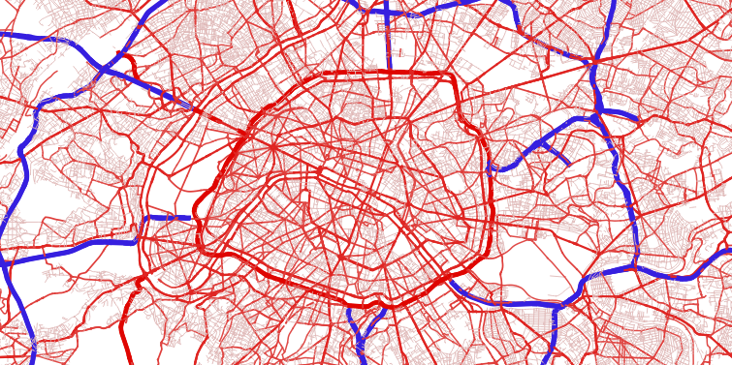
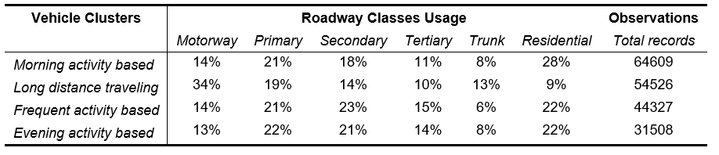
Map Matching with GIS Road Network
  To locate each record on certain roadways
  To join the road way information
Data Assembling
5 Roadway Usage Assessment
Data Preparation
Notes:
Cost effective
easy to deploy
high temporal resolution
wide spatial coverage
Travel behavior analysis not fully excavated
Great potential in travel behavior analysis, exp. variation over time, OD specific heterogeneity and exploration with big data

Slide 26
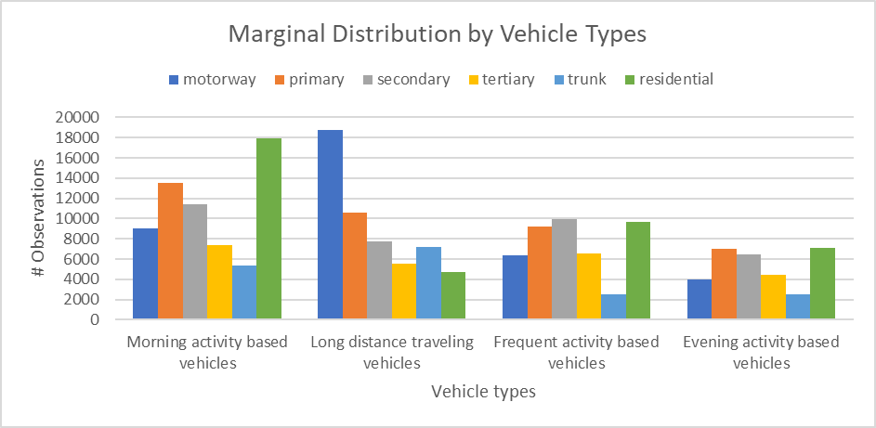
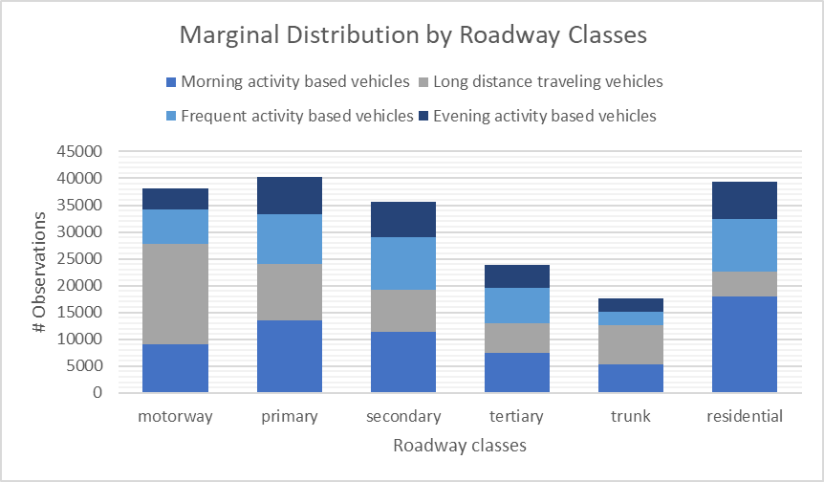
by Roadway Classes
Different user configuration
by Vehicle Types
Different road usage preference for each vehicle type
5 Roadway Usage Assessment
Marginal Distribution Analysis (1)
Notes:
To visualize

Slide 27

CFA tests whether significant relation exists for a certain combination of two categories (configuration)
  If Observed $O_{ij}$ > Expected $E_{ij}$ (under the assumption that no relation exists)
  Non-parametric test: significance by binomial statistic $Z_{ij}=\frac{O_{ij}−E_{ij}}{\sqrt{E_{ij}(1−p_{ij})}}$ ^{(Eye et al., 1996)}
An example
Vehicle Type | Roadway Classes
 | 1 | 2 | … | n
1 | O > E
…
n
For configuration (1-1): If # observations statistically higher than expectation
→ Vehicle type 1 statistically significantly use more of Roadway Class 1
5 Roadway Usage Assessment
Statistical Test-Configural Frequency Analysis
Notes:
math
Cost effective
easy to deploy
high temporal resolution
wide spatial coverage
Travel behavior analysis not fully excavated
Great potential in travel behavior analysis, exp. variation over time, OD specific heterogeneity and exploration with big data

Slide 28
Results of CFA
“Higher” indicate Significant more usage
Conclude into 3 major findings
Vehicle Type | Roadway Classes
 | Motorway | Primary | Secondary | Tertiary | Trunk | Residential
Morning Activity Based |  |  |  |  |  | Higher
Long Distance Traveling | Higher |  |  |  | Higher
Frequent Activity Based |  |  | Higher | Higher |  | Higher
Evening Activity Based |  | Higher | Higher | Higher |  | Higher
*All findings were significant at 99.9% confidence level
5 Roadway Usage Assessment
Results of CFA (1)
Notes:
Cost effective
easy to deploy
high temporal resolution
wide spatial coverage
Travel behavior analysis not fully excavated
Great potential in travel behavior analysis, exp. variation over time, OD specific heterogeneity and exploration with big data

Slide 29
Long Distance Traveling vehicles had a significantly higher usage on Motorways and Trunk , while the other 3 types used more of residential roads.
Vehicle Type | Roadway Classes
 | Motorway | Primary | Secondary | Tertiary | Trunk | Residential
Morning Activity Based |  |  |  |  |  | Higher
Long Distance Traveling | Higher |  |  |  | Higher
Frequent Activity Based |  |  | Higher | Higher |  | Higher
Evening Activity Based |  | Higher | Higher | Higher |  | Higher
*All findings were significant at 99.9% confidence level
5 Roadway Usage Assessment
Results of CFA (1)
Notes:
Cost effective
easy to deploy
high temporal resolution
wide spatial coverage
Travel behavior analysis not fully excavated
Great potential in travel behavior analysis, exp. variation over time, OD specific heterogeneity and exploration with big data

Slide 30
Frequent Activity Based vehicles and Evening Activity Based vehicles were found significantly more presented on secondary and tertiary roadways.
Vehicle Type | Roadway Classes
 | Motorway | Primary | Secondary | Tertiary | Trunk | Residential
Morning Activity Based |  |  |  |  |  | Higher
Long Distance Traveling | Higher |  |  |  | Higher
Frequent Activity Based |  |  | Higher | Higher |  | Higher
Evening Activity Based |  | Higher | Higher | Higher |  | Higher
*All findings were significant at 99.9% confidence level
5 Roadway Usage Assessment
Results of CFA (2)
Notes:
Cost effective
easy to deploy
high temporal resolution
wide spatial coverage
Travel behavior analysis not fully excavated
Great potential in travel behavior analysis, exp. variation over time, OD specific heterogeneity and exploration with big data

Slide 31
Only Evening Activity Based vehicles were found significantly related the usage of primary roads.
Vehicle Type | Roadway Classes
 | Motorway | Primary | Secondary | Tertiary | Trunk | Residential
Morning Activity Based |  |  |  |  |  | Higher
Long Distance Traveling | Higher |  |  |  | Higher
Frequent Activity Based |  |  | Higher | Higher |  | Higher
Evening Activity Based |  | Higher | Higher | Higher |  | Higher
*All findings were significant at 99.9% confidence level
5 Roadway Usage Assessment
Results of CFA (3)
Notes:
Cost effective
easy to deploy
high temporal resolution
wide spatial coverage
Travel behavior analysis not fully excavated
Great potential in travel behavior analysis, exp. variation over time, OD specific heterogeneity and exploration with big data

Slide 32
Contents
Introduction
Data Reconstitution
Descriptive Analysis
Type Identification
Roadway Usage Assessment
Conclusion and Discussions

Slide 33
Conclusion: Findings of social facts
4 major vehicle types can be identified based on mobility patterns using FCD over the Ile de France region,
The 2 leading types are Morning Activity Based vehicles (32.8% population) and Long Distance Traveling vehicles (31.1% population)
Different types had significantly different usage along different classes of roadways
Notes:
a methodological instance to better understand mobility pattern through big data

Slide 34
Limitations and Future Work
Extending analysis scope spatially and temporally
  Day to day analysis
  Inter-city mobility patterns
Integrate with other data source/ analysis to better recover the mobility context
  Land use; City structure; Household Survey, etc.
More comprehensive data mining methods and big data techniques
  Better accuracy & Higher efficiency
Notes:
Map matching?
Trip segmentation?
Increase sample size
More data and features
More comprehensive algorithm
choice

Slide 35

Thank you for your attention!
Notes:
Logo of ENPC and Telecom

Slide 36
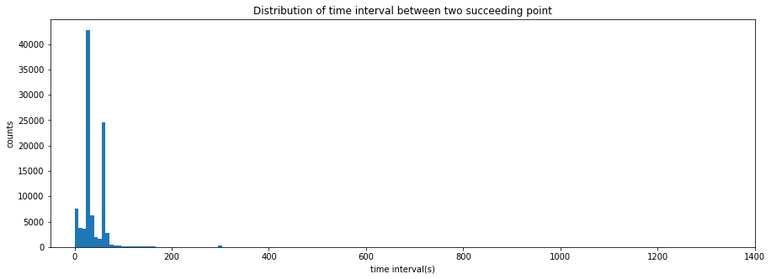
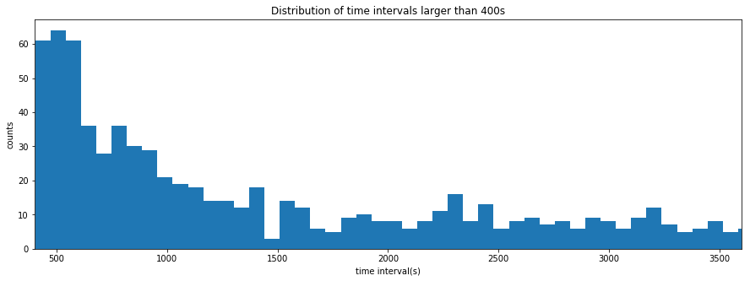
Time Interval Inspection-Preliminary Analysis
Segmenting the trajectories into meaningful trips
No absolute indicator in original dataset
→ not able to truly know whether a trip stop or not?
Future Work 1) Logical interpretation from Survey Data (EGT)
2) More advanced learning to the stop of trip
low threshold may include “fake stops” ( tunnels)
high threshold may miss some “true stops”
Notes:
Y axishigh threshold may miss some “true stops”

Slide 37
1 Introduction
Background
  Digital revolutions → profound changes with massive data
  Mobility entities connected → geo-locations all day long
  Fundamental knowledge → understand mobility in space and time
Notes:
As we all know, digital profound changes in our lifes especially with massive data
In mobility field enable, more and more are connect enable us
This actually provides

Slide 38
1 Introduction
Floating Car Data: a “new” solution to data availability “concern”
  Essence: vehicle traces via onboard GPS (Tomtom, Coyote)
    Info: localization+Instantaneous state by every minitute
  “New” : growing diffusion → massively available nowadays
  Cost-effective & Rich information
    High spatial-temporal coverage
    Detailed routes and up-to-date mobility demand
Notes:
Among them
New Although gps is now new
Cost effective
easy to deploy
high temporal resolution
wide spatial coverage
Travel behavior analysis not fully excavated
Great potential in travel behavior analysis, exp. variation over time, OD specific heterogeneity and exploration with big data

Slide 39
1 Introduction
Literature review
  Highlights
    Estimate traffic state of the road network: speed, congestion etc.
    Estimate traffic demand and traffic flow
  Gaps
    Lack of mobility perspective analysis based on FCD
    Knowledge gap in studying vehicle usage pattern
    Limited exploration of anonymous low frequency data (in minute)
Notes:
By doing the lit review
The highlights of the previous
Although gps is now new
Cost effective
easy to deploy
high temporal resolution
wide spatial coverage
Travel behavior analysis not fully excavated
Great potential in travel behavior analysis, exp. variation over time, OD specific heterogeneity and exploration with big data

Slide 40
Contributions: Methodological outcomes
Propose a holistic data mining approach to identify vehicle typology using low frequency FCD
Link the type identification with statistical relation to main phenomenon of interest: usage of roadways, violation, accidents
Overall, used as a methodological instance to better understand mobility pattern through big data
  Results may assist in improving network regulation and planning

